Slide 1
Microelectronic Control Systems
PWM, Servomotors with ATmega8

Slide 2
Educational objectives
During this lecture you will learn
• How to provide an anolog signal as an output (without DAC)
• How to use PWM for analog output
• What is a servomotor, how to control it
• Interfacing of MCUs with servomotors
• How to debug your programs over UART
• How to measure resistance with ATmega8
• How to measure capacitance with ATmega8

Slide 3
Continuous variation of output
Until now we switched the LEDs on or off — nothing in between. How
can we control the voltage or power in a load continuously?
The obvious solution is a digital–analog converter (DAC). This is of
course the opposite of an analog–digital converter (ADC). For DAC: the input is a digital value and the output is an analog voltage:
output voltage = (digital input value / maximum value) ^{x} reference voltage
Similar issues arise as with ADCs: for example, there is little point in having
a very precise DAC (lots of bits) unless the reference voltage is accurate
and stable.
You may be surprised to hear that few microcontrollers contain DACs
except in devices intended for particular applications, such as audio. If you really need one, you will probably have to find a separate device and control it from your μC with I²C or a similar interface.

Slide 4
Analog output — pulse width modulation (1)
Most microcontrollers provide only digital outputs (logic 0 or 1). Transistors
are also much more efficient when acting as on–off switches, rather than
producing intermediate outputs. They dissipate a lot of power when neither
completely on nor off. How can we control an output continuously by
only switching it on and off?
The common method of simulating a continuously variable output is pulse
width modulation (PWM):
The duty cycle of a square wave is varied to change the average power delivered to a load.
The frequency of the square wave must be high enough not to be noticeable.
• Drive the LEDs slowly to make PWM visible!
• Many loads, such as heaters, response very slowly
• Inductive loads, such as motors, provide smoothing themselves
• A low-pass filter is needed for sensitive loads (usually a RC circuit)

Slide 5
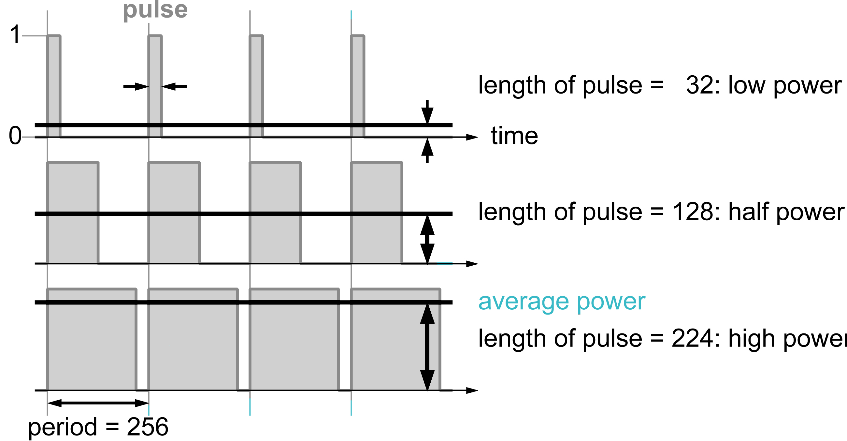
Analog output — pulse width modulation (2)
For example,
• period of square wave = 256 units
• vary duration of pulse (output = 1) from 0 (fully off) to 256 (fully on)
period = 256

Slide 6
How to generate PWM waveforms
This can be done in software using a loop with delays to switch the load on
and off. For example, this will run an LED at 50% power.
How to generate PWM waveforms
PWMLoop:
high 0 ; turn on LED
pause 1 ; wait 1 ms similar to our 1 Hz LED
low 0 ; turn off LED
pause 1 ; wait 1 ms
goto PWMLoop ; back around infinite loop
The average power could be varied by changing the two pauses, although
you have to be careful about timings. For good control you really need finer resolution than 1 ms — it’s too coarse. See hardware realisation later.
In general you might have a ‘for–next’ loop with a variable counter. This
runs from 0 to period but the load is switched on only while counter lies
between 0 and duty. The average power is then duty/period.
Fortunately, out ATmega8 can do this automatically in hardware.

Slide 7
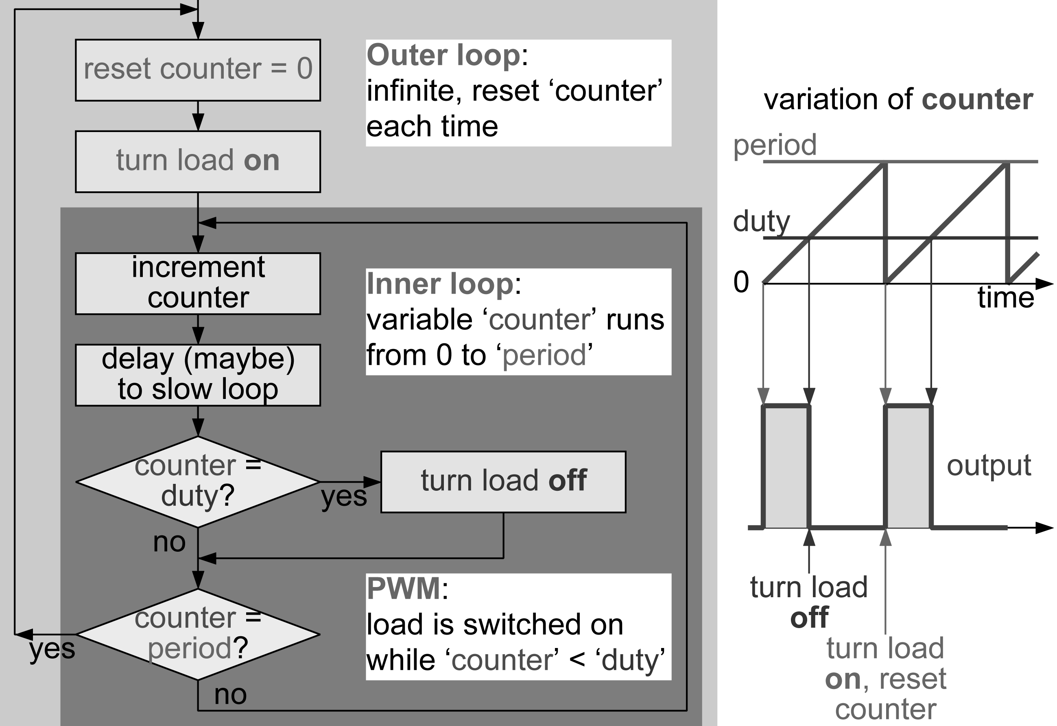
Generation of PWM waveforms in software

Slide 8
Generation of PWM waveforms in hardware
Many microcontrollers contain one or more timers to generate these
waveforms: they run automatically after loading the period and length (duty)
of the pulse.
This works in exactly the same way as the software on the previous slides.
The module is based around a counter fed by the clock used by the rest of
the microcontroller. This is equivalent to the variable counter in software.
Each time it is incremented, the counter is compared with two registers:
• when the counter reaches the value in the duty register, the load is switched off
• when the counter reaches the value in the period register, the counter
is reset and the load is switched on (unless duty = 0)
The ratio of the values in the duty : period registers sets the duty cycle and
hence the average power supplied to the load, just as in the software.

Slide 9
Perils of PWM
Because PWM is generated by a counter, there is a trade-off between
speed and accuracy.
• high accuracy means that ‘duty’ and ‘counter’ need a large range
• this means that ‘period’ must also be large and the loop will be slow
Example:
• Suppose that 256 possible values of the output are needed (8 bits).
• The period should therefore be 256 so that ‘duty’ can range from 0 to 255 (always off to always on).
• If the μC executes an instructions every μs (=1 MHz), one period takes a
minimum 256 μs ≈ ¼ ms, which corresponds to a frequency of 4 kHz.
• This is in hardware; in software, each iteration of the loop requires
about 4 instruction cycles — even slower.
Care is needed when duty is updated to avoid glitches in the output. In
hardware the CCP module should do this correctly for you.

Slide 10
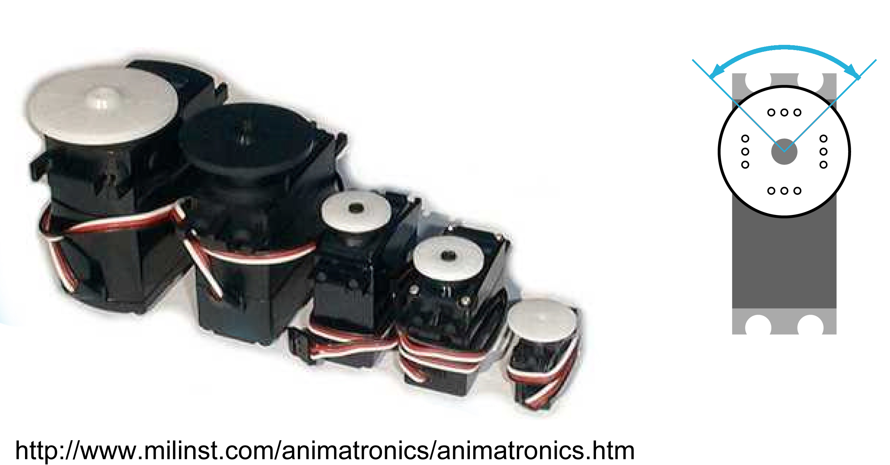
Remote control servos
These are often used to control model aircraft, cars and the like. They do
not turn continuously like a motor, but rotate their output through a range of
90°(or ±90º). They are controlled by sending a stream of pulses at 50 Hz.

Slide 11
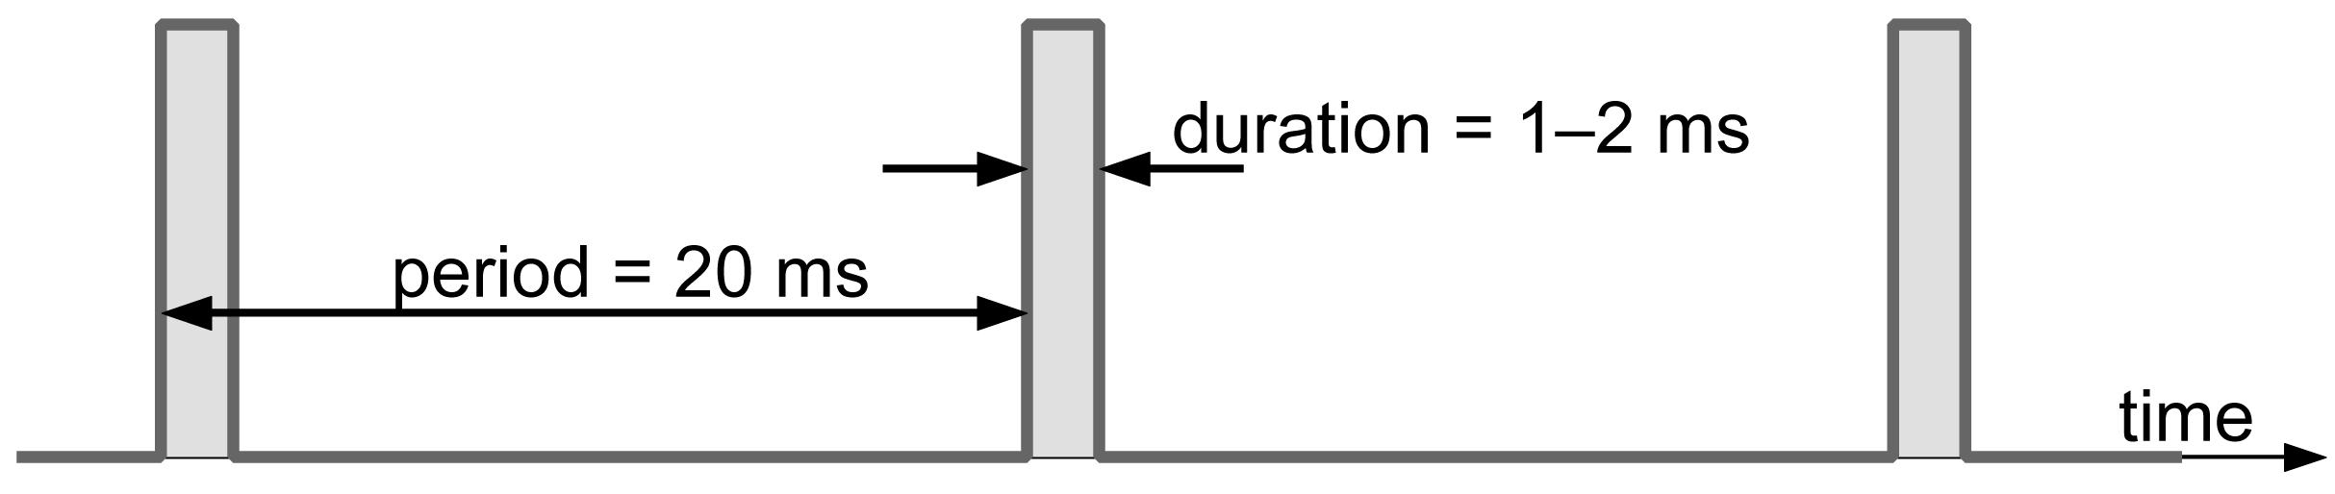
Control of servos
Servos are controlled by a stream of pulses (roughly to scale):
The position of the servo depends on the length of the pulse, for example:
1.0 ms — far left (–45°or –90º)
1.5 ms — centred (0°)
2.0 ms — far right (+45°or +90º)
The pause 20ms instruction can be used to give the interval between pulses
but is too coarse for the pulses themselves because the duration is in ms
(milliseconds). Instead, use PWM.

Slide 12
Microelectronic Control Systems
Ball and Seesaw

Slide 13
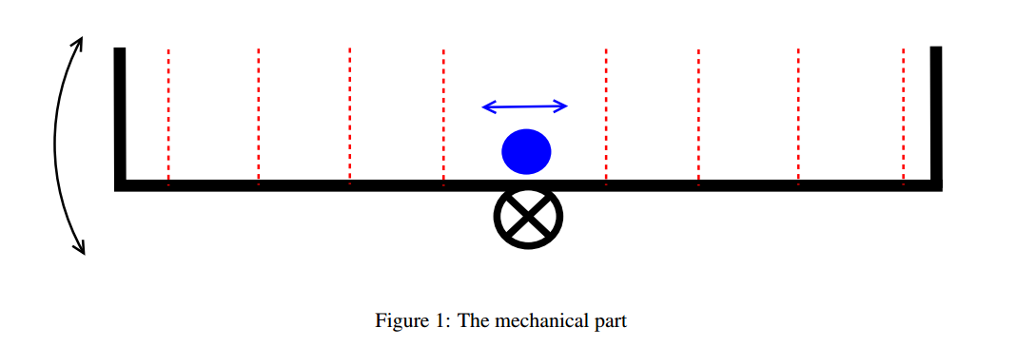
Device principles
A schematic of the device actuator:
Variable you need to control: ball position (x)
Actuated variable: angle
If you draw a triangle of gravity, normal force and tangential force, you will see that acceleration is
a = g*sin(angle) – Ffriction / m. Around very small angle values this can be linearized to a = g*angle, omitting the friction

Slide 14
Device sensors = optocouplers
Your sensors are, however, limited to few positions and can not continuously supply you with the coordinate reading. You will only know when ball crosses the LEDs, but no information is available when ball is e.g. between 2 LEDs.

Slide 15
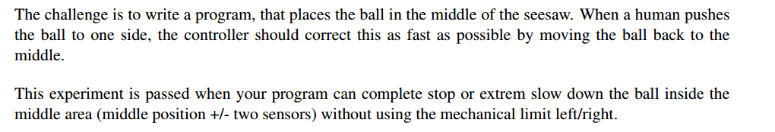
Task formulation
Target region.
You should:
Stop ball in this region
Keep ball moving strictly inside this region
1
2
3
4
5
6
7
8

Slide 16
Theory behind solution ‘a’
Solution a:
Stop the ball. As you can never have perfectly 0 angle, what really can stop the ball is the friction. However, for round rolling ball it is weak, therefore speed must be already low for the ball to stop.
Conclusion: you need to bring ball to low speed near the middle. This is best achievable with D controller.
Important: if you react to speed of ball by giving it even bigger speed in another direction, the result is unstable system. Your action must be less than initial speed to which you react. Use this idea to guide you in choosing right D part coefficient. Experiment to find value which fits.

Slide 17
Theory behind the solution ‘b’
Solution b:
Keep ball moving strictly inside target region.
You might notice that around corners you may have situation when ball starts to move to the center, and D controller returns it into the corner.
This is bad, however, it shows possible solution: if you implement some condition for D controller to be stronger, yet stable in the middle region, the ball can get trapped between position 4 and 5.

Slide 18
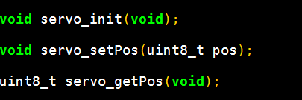

Template: sensor readings & servo position
Notice the 2 init functions you must run to make system functional.
The servo can be set using servo_setPos(uint8_t pos) function.
irsensors_getRawPos() returns 0 if no sensor is in contact with the ball, otherwise sensor number (as in slide 15).

Slide 19
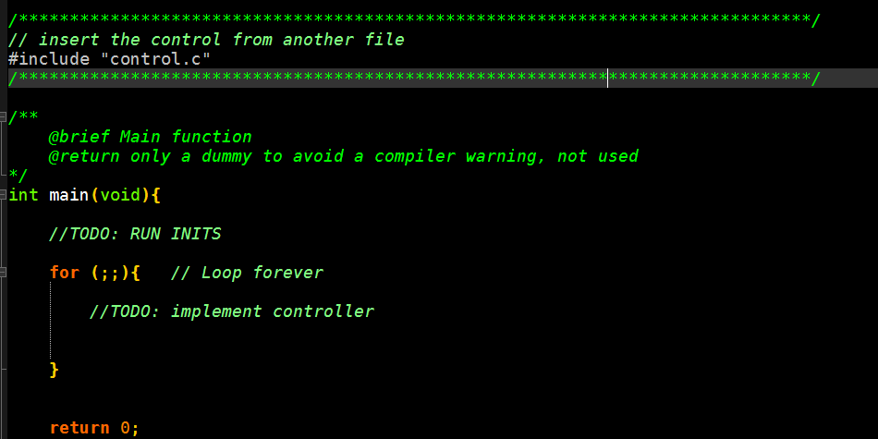
Template: main file
Complete the TODO parts. #include „control.c“ line can be deleted.
Aside from the controller in the main loop, you might want to use interrupts, but this is not strictly necessary in this lab.
For hints on how to implement a P, I, D controller, refer to our last lecture.

Slide 20
Pitfalls of Seesaw 1
Problem 1: Ball stops outside of target region
The experiment will be started by rolling a ball on some of the sensors. Our goal is to set it to a stop, but it can stop at the wrong place.
Solution: keep the track of last place where the ball was seen! If it is not sensors 4 or 5, then ball is not at the right place yet. Move it in the direction of the center.

Slide 21
Pitfalls of Seesaw 2
Problem 2: The ball jumps out of Seesaw / Seesaw hits the ground / my D control does not work. The real problem here is that Seesaw needs time to smoothly change angle.
Solution:
Apply your actuation with delays, like:
void myOutputFunction(output){
servo_setPos(const+output/10);
_delay_ms(40);
servo_setPos(const+output/5);
_delay_ms(40);
servo_setPos(const+output/10);
_delay_ms(40);}
Risk: during delay, you might miss a sensor reading.
Use Timer/Counter to work around this problem.

Slide 22
Pitfalls of Seesaw 3
Problems 3a and 3b: Ball never stops / jumps out of Seesaw
Many controllers and parameters can lead to unstable behavior (3a, big D or I part) , or to behavior where ball stably moves from 1 to 8, and back ( 3b, which would happen to P or I controller).
Solution:
3a – keep decreasing the coefficients for your controller until it is stable, with movement decaying
3b – DO NOT use pure P or I controller. It is not fit for this task.
If you use full PID, try to set P to zero, and check if this improves behavior.

Slide 23
Pitfalls of Seesaw 4
Problem 4: I implemented good D controller and took care of all previous pitfalls. I tried solutions a and b, yet I cant stabilize the ball.
Solution:
Demonstrate your progress to the staff.
You will receive some recommendation on how to proceed.
Implement recommendations
If you have high quality code addressing all the issues, and it works at least 50% of the time, you pass.

Slide 24
Advanced solutions
Few solutions exist to address difficulties of this lab and make your program work much better:
Smooth actuation: With a Timer/Counter you will be able to extend your reaction to 1 second and more without missing the sensor readings. Think about what shape must the signal have.
Use Observer: Having a simulated model of the system running inside the microcontroller and updating it every time actual observation is made can allow much more precise control.
Experimentally find acceleration as a function of the angle, use it to calculate coefficients for the controller and observer.

Slide 25
Microelectronic Control Systems
Levitating Magnet

Slide 26
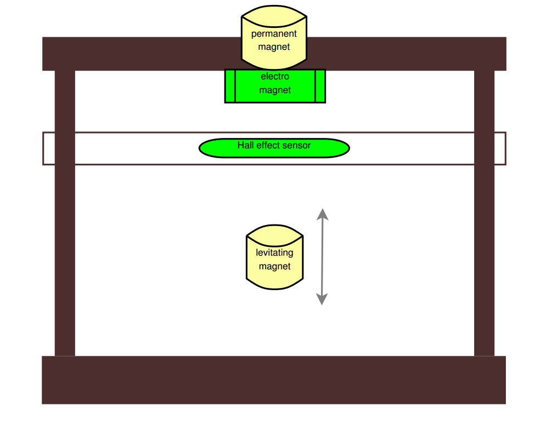
Setup & Controller parameters
The levitating magnet is very fast system: the area where you can control the levitating magnet is about
2 cm, which it can leave within
t = Sqrt(2*L/g) or about 63 ms.
The actual time to lose control of the system is even smaller (calculation assumes you can overpower any speed as long as magnet is close enough. This is not the case.)
Remark: time calculation based on equation for
free fall with x0 = 0, v0 =0 and x(t) = 0.02 m
sqrt(2*0.02/9.81)=0.063855

Slide 27
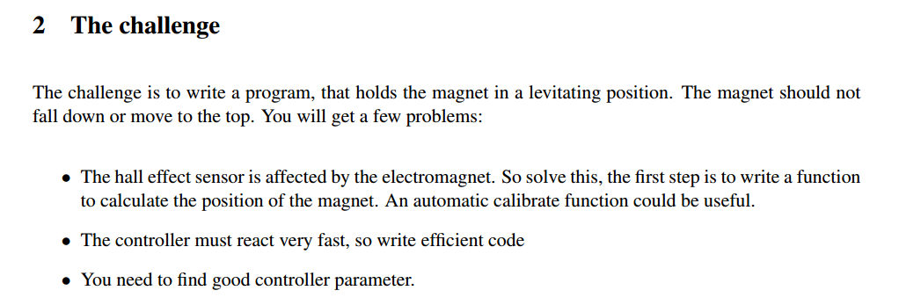
The task
From the lab document:
First point is already complete in the template.

Slide 28
Appropriate controller
Theoretically, PID controller may seem like the best solution.
From previous experience: the most important is D part to dissipate speed. You also will need a P component, but it will have greater range of parameters at which the system is stable.
Integral part had frequently led to less stable system.
Advice: avoid it or limit it to small maximum value.
Start by testing a 2 point controller and look for appropriate setpoint. Depending on the mass of the magnet, some setpoints are simply not achievable.

Slide 29
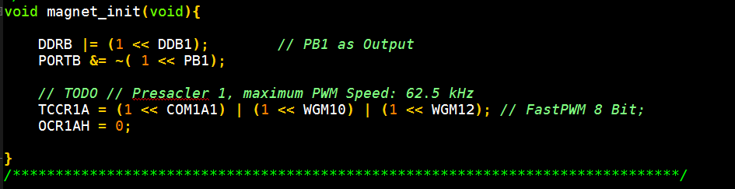
Completing the template
Magnet.c contains following TODO:
Hint: read about Timer/Counter1 waveform generation. TCCR1B is relevant.

Slide 30
Using the template
As mentioned, template handles the Hall Effect Sensor calibration.
As soon as //TODO is completed, you can use following function for sensor reading:
uint8_t hall_get( void ); // myReading = hall_get();
For actuation, use:
void magnet_set( uint8_t power); //power for magnet
void hall_setmagpower( uint8_t power); //inform the sensor about needed offset
Remark: If you do not know how to construct a controller, refer to our last lecture

Slide 31
Improving control
As soon as you will have your PD controller set up, consider following:
If your controller is very quick (example: one cycle every 100 us) then after a change in hall sensor was detected ( speed != 0), your D parameter will have effect only for 100 us! This might not even be enough to change current in electromagnet (there is energy stored in magnetic field).
This is simple to solve: average last 8 or more speed readings. This makes system resistant to measurement noise as well.

Slide 32
Microelectronic Control Systems
Debugging levitating magnet and seesaw using UART

Slide 33
UART
UART stands for Universal asynchronous receiver/transmitter.
Both Seesaw and Levitating Magnet have a port for UART connection to the PC.
Why is this useful? Because you can send any data to the PC, like to an LCD. If you are not sure why your program does not do what you wanted it to – check and analyze it step by step (Debug it).
In Levitating Magnet template, you can find files uart.h and uart.c;
Copy them to your seesaw folder.

Slide 34
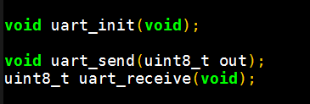
UART template
In the uart.h we can see the functions provided by the template:
As long as you just want to see your data on the PC, you need:
Initialize UART using uart_init();
Use uart_send(uint8_t out); to send a byte of your data. If you use 16 bit variables (uint16_t my16), use:
uint8_t highByte= my16/256, lowByte= my16%256;
uart_send(highByte);
uart_send(lowByte);

Slide 35
UART monitor for Ubuntu workstation
We recommend to use following software to display the values you recieve: gtkterm (call it from the console).
Remember to:
connect UART with miniUSB >> USB
Open Configuration > Port, and choose the right USB port.
If you only see question signs, go to View >> Hexadecimal.
If you want to make a plot, you can save your data in a file from gtkterm.

Slide 36
Microelectronic Control Systems
Component tester

Slide 37
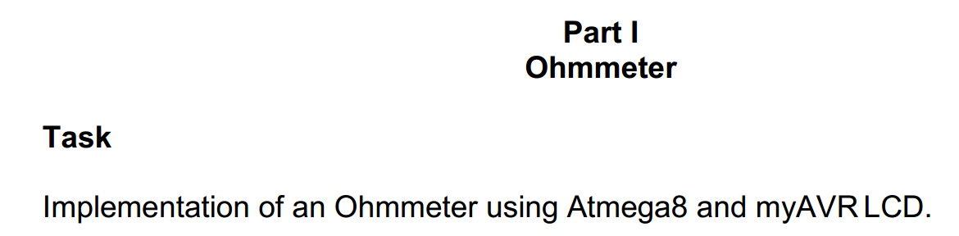
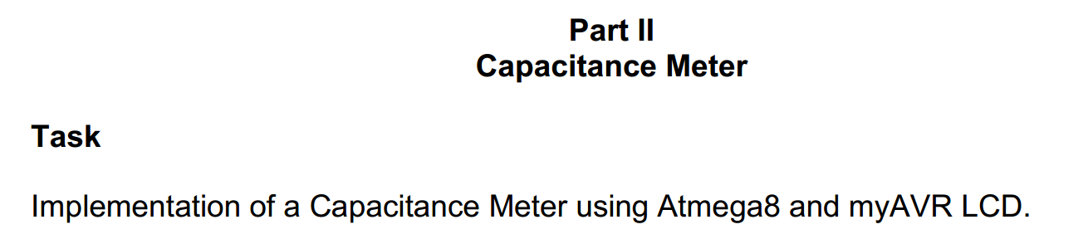
Goal of Component Tester
When you have both parts, combine them: you should have logic (if statement + flag, for example) in your program to determine if component is a resistor or capacitor.

Slide 38
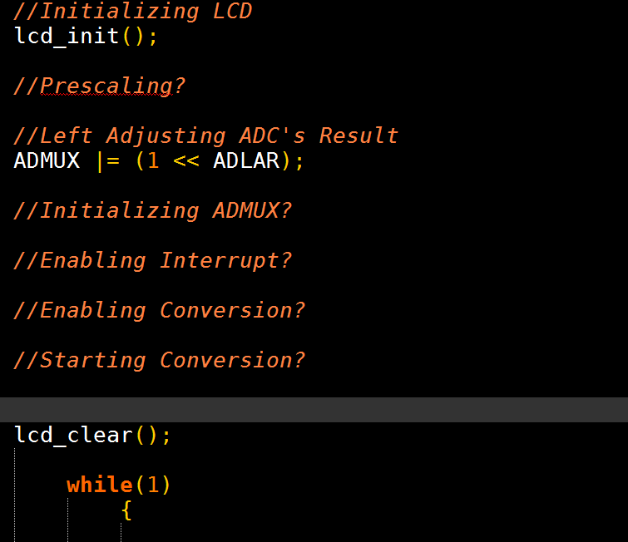
Template: init
You are given following as a code to start with:

Slide 39
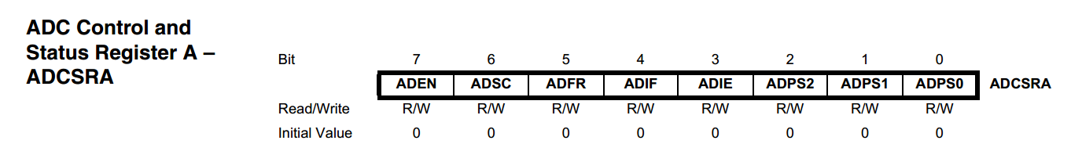
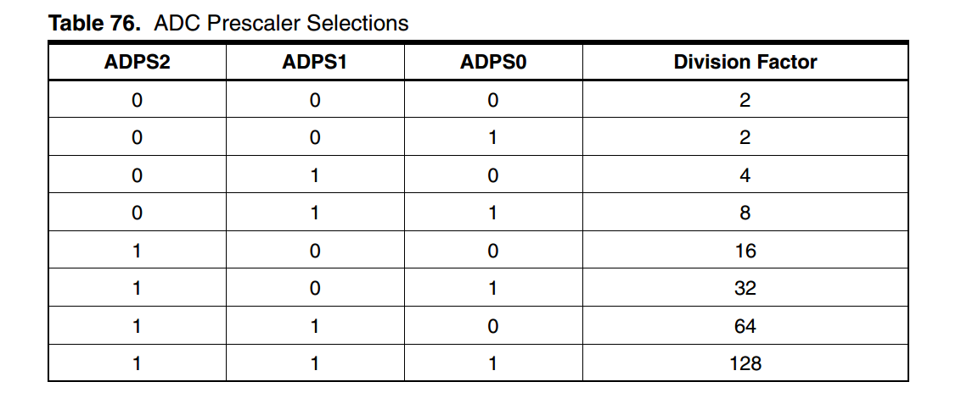
Template: ADC init
The template guides you through the meaning of the init procedures.
You should deal mostly with ADC control & status register:
For prescaling (determines how fast conversion is made; perhaps your priority should be precision, not speed) select following bits:

Slide 40
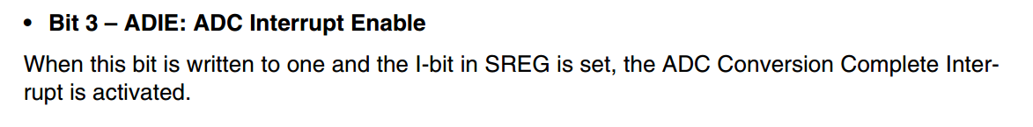
Template: ADC init 2
Initializing ADMUX: MUX3, MUX2, MUX1, MUX0 bits determine on which pin the voltage is read (only PINC is connected to ADC).
To choose values for MUX3..0, write your pin number as binary number.
Example: PC5 : 5 = 101 binary, or 0101.
Therefore: ADMUX |= (1<<MUX2) | (1<<MUX0);
For other subtasks of init ( //Enabling Interrupt? //Enabling ADC?)
Add two more bits to ADCSRA.
* ADEN – ADC Enable

Slide 41
Template: Using ADC with Interrupt
Now ADC works NOT in free running mode, meaning you must tell it to do conversion at the moment you want it. Do it using:
ADCSRA |= 1<<ADSC;
As soon as conversion is done, ADC interrupt will be called.
Remember: only volatile variables can be modified in the interrupt.
If you use LCD in interrupt, and it behaves strange, use LCD
(and sprintf(..); ) in main loop instead.

Slide 42
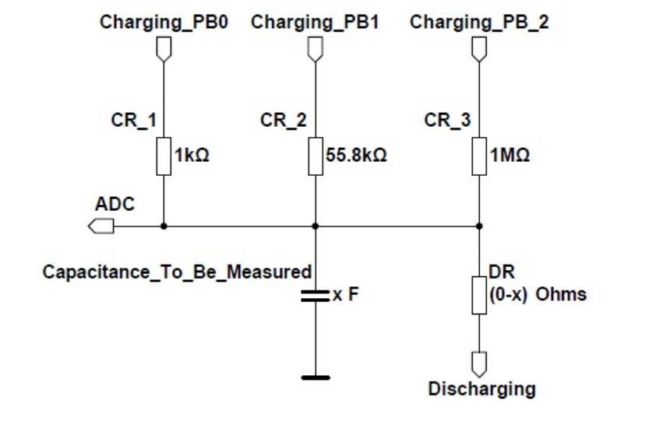
Finding R of a resistor
In the lab guide a simple circuit for finding resistor is shown.
However, for capacitor we use 3 resistors.
Why?
Could 3 resistors be useful for Ohmmeter?

Slide 43
Finding R of a resistor (more precisely)
Why?
Because for small capacitor, it may be charged too quickly over small resistor value. This will impair the precision of the measurement.
Therefore, for each capacitor optimal measurement will be done with appropriate resistor (small capacitor, bigger resistor / big capacitor, smaller resistor).
Could 3 resistors be useful for Ohmmeter?
Yes! The most precise resistance measurement is possible when voltage divider compares two resistors of similar values!
Hint: use circuit for capacitor for resistor as well, as you need to have one device for both types of components in the end

Slide 44
Finding R of a resistor (3)
So how to properly use circuit with 3 input resistors?
For a resistor, you do not need discharge pin. Let it always be input pin (high impedance, tiny current).
Only one line should be set to output / high at a time. Modify your DDRs at the runtime to achieve this!
If your measured voltage is almost 5 volt (maximum) or 0 volt (minimum), consider running another measurement with different resistor.
Mind 16 bit integer calculations: multiplying by 55800 Ohm for resistor CR_2 is a bad idea, as any useful measurement will overflow.

Slide 45
Finding C of a capacitor
Formula : t = RC; C = t / R.
To measure time constant t, you will need a Timer/Counter. Timer/Counter1 with 16 bit can give advantage of more precise time measurement.
You can always set TCNT to 0 when you start charging not to deal with time difference.
Since charging through small resistor is quicker, start with this. You can also modify prescaler of your Timer/Counter during runtime.
Again, attention to 16 bit integer operations. If you are in trouble here, you can try to create your own „long uint32“ made of HIGH and LOW uint16 parts. But: you must write +, -, *, / operations for this data type.

Slide 46
How to: combine R and C measurement
„When you have both parts, combine them: you should have logic (if statement + flag, for example) in your program to determine if component is a resistor or capacitor.“
What test can you run to see if it is a capacitor or resistor?
Device your own test using following facts about C and R:
For a capacitor you can always find a resistor to find time dependence of the reading (there must be two different readings. Try to set exponential time scale (e.g. after 1, 10 ,100, 1000 timer tics) and try all resistors.
If you measured time constant of RC system, you can check that if measurement is correct, after 5 time constants voltage should be 99% of Vcc.

Slide 47
Example of program flow
Uint8_t know_device_type_flag, is_C_flag, is_R_flag;
While(1)
{
if( ! know_device_type_flag )
test_device_type();
if ( is_C_flag )
measure_C();
else if ( is_R_flag )
measure_R();
else
display_error();
}

